Slide 1
Nikita Patrick-Thomas, NCC
PCHS Counselor
Reporting
mandatory
pchscounselor.com

Slide 2


who is a
mandatory reporter?
In Alabama, school employees are mandated reporters.
Teachers, counselors, administrators, coaches, nurses, and other school personnel have a personal responsibility to report suspected child abuse or neglect.
Reporting it to the counselor does not transfer your responsibility to the counselor.
pchscounselor.com

Slide 3

09 May, 2026
your
responsibility
suspect → report; you do not investigate or prove
You do not need proof that abuse or neglect occurred.
If you have reasonable cause to suspect a child may be experiencing abuse or neglect, your responsibility is to report the concern—not determine whether the allegation is true.
Recognize. Respond. Report. Support.
pchscounselor.com

Slide 4

recognizing
physical abuse
Physical abuse may leave visible injuries, but the explanation, pattern, or student’s behavior may be just as important as the injury itself. Look for changes and inconsistencies—not just bruises.
UNEXPLAINED INJURIES
INCONSISTENT EXPLANATIONS
BEHAVIORAL CUES
Bruises, burns, welts, fractures, or injuries in unusual locations or at different stages of healing.
The explanation doesn’t match the injury, changes over time, or seems inconsistent with the student’s age or development.
Fear of going home, flinching at touch, sudden withdrawal, unusual aggression, anxiety, or wearing clothing that repeatedly conceals injuries.
pchscounselor.com

Slide 5

recognizing neglect
Neglect may be less obvious than physical abuse. Look for persistent patterns suggesting that a child's basic needs for care, supervision, health, or safety are not being met.
  BASIC NEEDS
Persistent hunger, poor hygiene, inappropriate clothing, significant weight loss, or lack of adequate shelter.
  MEDICAL & PERSONAL CARE
Untreated injuries or illness, needed medical/dental care not provided, or necessary medications or assistive devices unavailable.
  SUPERVISION & SAFETY
Frequently left without appropriate supervision, unsafe living conditions, or repeated situations that place the child at risk.
pchscounselor.com

Slide 6
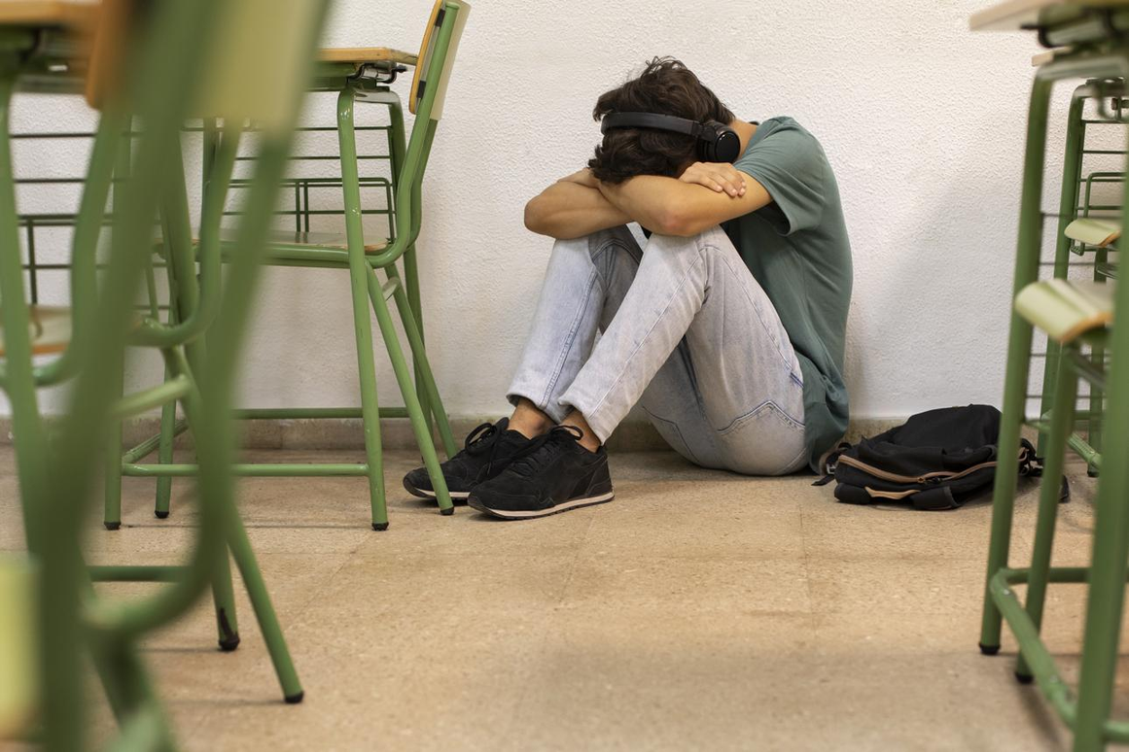
recognizing emotional abuse
Emotional abuse may not leave visible injuries. Watch for significant or persistent changes in a student’s behavior, emotional well-being, relationships, or sense of self-worth.
  EMOTIONAL & BEHAVIORAL CHANGES
Withdrawal, depression, anxiety, extreme fearfulness, aggression, or sudden changes in personality.
  WORDS & TREATMENT
Persistent humiliation, threats, intimidation, rejection, belittling, or being made to feel unwanted or worthless.
  CHANGES AT SCHOOL
Sudden decline in grades, frequent absences, isolation from peers, difficulty concentrating, excessive need for approval, or fear of making mistakes.
pchscounselor.com

Slide 7

sexual abuse & exploitation
Sexual abuse and exploitation may involve physical contact, grooming, coercion, sexual communication, images, or online activity.
A student may disclose directly—or show behavioral changes that raise concern.
pchscounselor.com

Slide 8
when a student discloses
what to say, what not to say, and avoiding promises of secrecy
DO — Listen & Support
Say things like:
“I’m glad you told me.”
“Thank you for trusting me.”
“I’m listening.”
“You did the right thing by telling someone.”
“I may need to share this with someone who can help keep you safe.”
DON'T — Investigate
Avoid:
“Are you sure?”
“Why didn't you tell someone sooner?”
“What exactly did he/she do next?”
“Who else knows?”
“I promise I won't tell anyone.”
pchscounselor.com

Slide 9
report vs investigate
Your responsibility is to report reasonable suspicion—not build a case. Asking unnecessary questions can interfere with a child’s disclosure and the investigation that follows.
REPORT — Your Job
DO:
Listen calmly
Allow the student to speak
Document what was said as accurately as possible
Report promptly
Follow required reporting procedures
Continue supporting the student
INVESTIGATE — Not Your Job
DON'T:
Interrogate the student
Ask leading or repeated questions
Interview other students
Confront the alleged offender
Call home to “get their side”
Try to determine whether the student is telling the truth
pchscounselor.com

Slide 10

“I told the counselor.”
Telling the counselor does not automatically transfer your reporting responsibility.
If a student discloses suspected abuse or neglect to you, you are a mandated reporter too. The counselor can support you through the process—but should not simply become the reporter because you passed along the information.
pchscounselor.com

Slide 11

confidentiality after a report
NEED-TO-KNOW ONLY
Share information only with appropriate personnel who need it to protect or support the student.
AVOID CASUAL DISCUSSION
No hallway, lunchroom, group-text, or staff-room conversations about the student, family, allegations, or report.
CONTINUE TO SUPPORT
Treat the student normally. Maintain a safe, supportive environment without repeatedly questioning them or asking for updates.
pchscounselor.com

Slide 12
remember your role
recognize.
Notice the signs. Trust reasonable concerns.
respond.
Listen calmly. Don't interrogate or promise secrecy.
report.
Act promptly. You are the mandated reporter.
support.
Protect privacy. Continue being a safe adult.
pchscounselor.com

Slide 13


thank you
Nikita Patrick-Thomas, NCC
PCHS Counselor
Cell: 334-233-7855
npatrick@pikecountyschools.com
pchscounselor.com

