Slide 1
Securing the Buy-In: Gaining Administrator Support for School Counselors
Nikita Patrick-Thomas, NCC, CDEI
Jasmine Reynolds,

Slide 2
Understanding the Challenge
School counselors often face difficulties in gaining administrative support
There can be a disconnect between school counselors and administrators
Overcoming this challenge is crucial for student success and school improvement

Slide 3

The Administrator's Perspective
•Administrators are focused on overall school performance and management
•They often ask, "What's in it for me?" when considering new initiatives
•Understanding this viewpoint is key to gaining support
How can counselor's align their goals with their administrator's perpective?

Slide 4

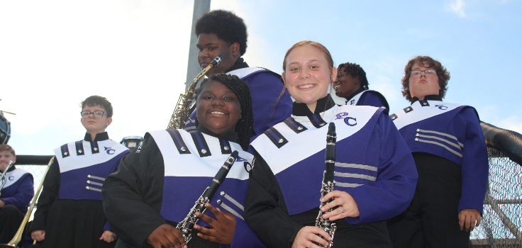

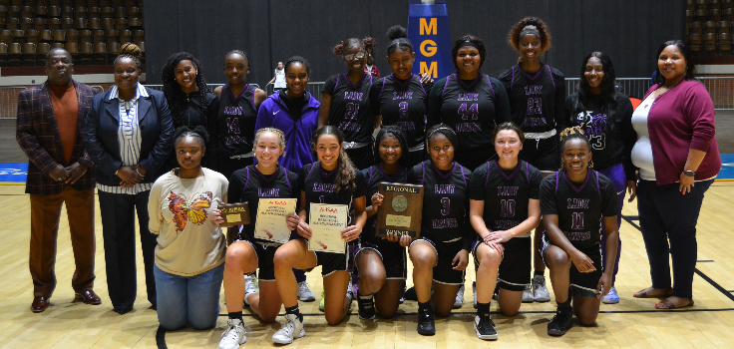

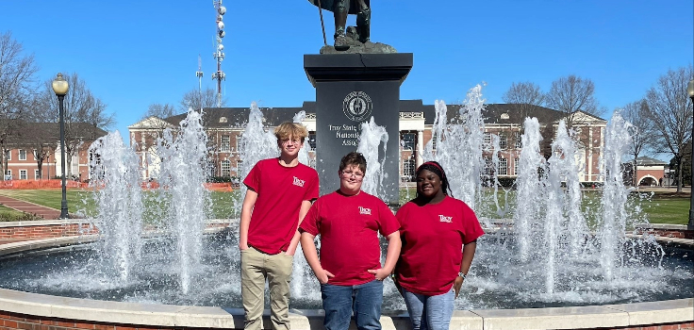


The Foundation!

Slide 5
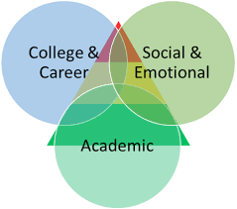
Staying Student-Focused
Remember that student well-being is the primary goal
Frame counseling initiatives in terms of student outcomes
Highlight how counseling programs contribute to:
  Academic achievement
  Social-emotional development
  College and career readiness

Slide 6

Benefits to Administration
Improved school climate and culture
Higher graduation rates and academic performance
Reduced disciplinary issues and absenteeism
Enhanced college and career readiness programs
Positive impact on school rankings and reputation

Slide 7

What does the School Counselor do anyway?

Slide 8
No worries! I have data.
Use data to support your initiatives and demonstrate impact
Present clear, concise statistics on:
Student achievement
Behavioral improvements
Counseling program outcomes
Show how data aligns with school and district goals
Need:
School data profile
Blank school data profile

Slide 9

Effective Communication Strategies
Schedule
Prepare
concise, well-organized presentations
Practice
regular meetings with administrators
visual aids and infographics to convey information
active listening and be open to feedback
Offer
solutions, not just problems

Slide 10
Aligning with School Goals
Familiarize yourself with the school's strategic plan
Demonstrate how counseling programs support:
  Academic excellence
  School safety
  Parent and community engagement
  College and career readiness initiatives

Slide 11

Collaborative Approach
Position yourself as a team player and problem-solver
Offer to assist with school-wide initiatives
Involve administrators in counseling program planning
Recognize and appreciate administrative support publicly
Foster relationships with other staff to build a support network

Slide 12

Professional Development and Growth
Stay updated on educational trends and best practices
Attend workshops and conferences on leadership and administration
Share relevant insights and resources with administrators
Demonstrate your commitment to continuous improvement
Position yourself as a valuable resource for the school community
Milestone | Quarter
First day | Q1
Winter break | Q2
Spring break | Q3
Last day | Q4

Slide 13
Conclusion: Building Lasting Support
Gaining administrative support is an ongoing process. Focus on student outcomes while addressing administrative concerns. Use data, effective communication, and collaboration to build trust.
Remember: A strong counselor-administrator partnership benefits everyone. Together, create a positive, supportive environment for student success

Slide 14

Thank you
Jasmine Reynolds, XXX,XXX
PUT YO EMAIL HEA
Nikita Patrick-Thomas, NCC, CDEI
Npatrick@pikecountyschools.com
Pchscounselor.com

